Slide 1
Compiler
❍ A compiler is a computer program that translates a program in a source language into an equivalent program in a target language.
❍ An interpreter is another common kind of language processor.
❍ A source program/code is a program/code written in the source language, which is usually a high-level language.
❍ A target program/code is a program/code written in the target language, which often is a machine language or an intermediate code.

Slide 2
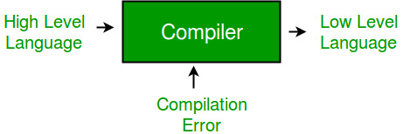
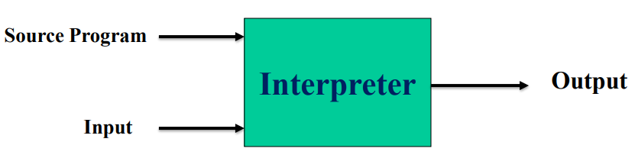
Compiler

Slide 3
Compiler
Compiler:
Translate all lines.
Execution is faster.
All errors after finishing.
Interpreter:
Translate line by line.
Execution is slower because translation is repeated.
Error clear.

